Slide 1

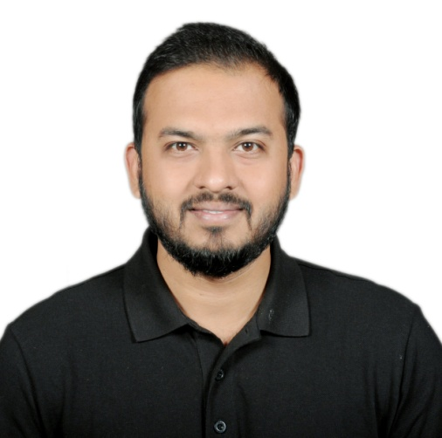


Professional Synopsis
Navin Ajit Dhote
Senior Java Developer
Overall, 8 years of experience in Backend Development of Web, Integration and Migration Platforms and Applications, Enterprise and Banking applications using JAVA Technologies, REST API, Microservices, Spring Boot, MuleSoft and, Database Development, Low Code Development and Experience of working in various Domains such as Telecommunication, Investment Banking, Finance, Liquidity Risk, Payments and Automobile.
Trainings & Certifications
2022 : Oracle Certified Foundations Associate in Oracle Cloud Infrastructure
2022 : Mendix Certified Rapid Developer
2022 : Python Essential Training Certification
2014 : Oracle Certified Associate in Oracle 11G Database – SQL and PLSQL
2014 : Currently pursuing for Mule 4 MCD Level 1 Certification
Education
Bachelors in Engineering in Information Technology
University of Mumbai
Aug 2011 – Aug 2014
Employment
Personal Details
Java Developer - Cloud Apps
Dec 2021 – Present
Accenture – Riga, Latvia
Navin Ajit Dhote
Projects Name:
BMW Retail Europe
Description
BMW Retail application is used to manage all the Operations and Sales for BMW in Europe.
Roles and Responsibilities: Backend Development of Applications in Java, creation of Spring Boot and Microservices based applications, Mule. Building the Integration and Communication between Systems using MuleSoft and REST API. Creation of new services as per new requirements with their specifications, Go-Live, Handling Development and Production issues. Deployment of Applications on Oracle Cloud and configuring CICD pipeline.
Technologies: Java 11, Mule 4, Anypoint Studio, Microservices Design Patterns, Core Java, Spring Boot, Microservices, RAML, Oracle Cloud, REST API, Elastic Search, Kibana, Junit, Jmeter, PostgreSQL, Postman, Git, Maven, Jira, Python.
navin.dhote214@gmail.com
+371 28131908 /+91 8291738956
Senior Software Engineer
Mar 2021 – Nov 2021
Riga, Latvia (Europe)
Globant - Pune, India
Projects Name:
HSBC Holdings UK
Description: Domestic Payment Operation in HSBC is a Solution to all HSBC Operations in UK
Roles and Responsibilities: Mainly responsible for Backend Development and Integrations using Web Services. Creation of REST API Architecture using MuleSoft and Microservices to Operate as an Integration specialist between Multiple Banking Applications. Responsible to take ownership of all the payment processing in UK operations for HSBC.
Technologies: Java 8, Mule 4, Anypoint Studio, Python, Mendix, Anypoint Platform, RAML, Eclipse, Robo Mongo, Postman.
23/04/1990
Male
Senior Analyst
Feb 2019 – Mar 2021
https://www.linkedin.com/in/navin-dhote-43394069
Deutsche Bank - Pune, India
Projects Name:
Galileo Payment System Hub
Description: Galileo Payment System is a Global Platform for Deutsche Bank to carry out the International and Domestic Payments all over the Globe using SWIFT, CHAPS, BACS, Instant Payments, Bulk Payments.
Roles and Responsibilities: Performing the Backend Development and Integration of various applications. Creation and Deployment of Microservices Applications that work together as a payment processing unit. Architecture and implementation of REST API’s and looking into CICD Pipelining and Deployments. Creation of Infrastructure, Go-Live, Disaster Recovery, Load Testing. Integration of heterogeneous applications.
Technologies: Java 8, Mule 4, Anypoint Studio, Core Java, Spring Boot, Microservices, OpenShif Cloud, RAML, SQL, PLSQL, Oracle11g, JIRA, Bit Bucket, Maven, Service Now, GIT, Team City, REST API, Intellij, Postman, Cucumber.
Skills
Java 8, Java 11, REST API, Spring Boot, Microservices, Agile, SQL – PLSQL, Oracle Cloud, OpenShift Cloud, Mule 4, Anypoint Studio, Microservice Design Patterns, Python, Jenkins, GIT, Mendix, BitBucket, IBM Message Queue, JMS, Junit, Cucumber, Selenium, Pair Programming, TDD, Java Design Patterns, Elastic Search, Kibana, Docker, Low Code Development
Senior Software Engineer
May 2017 – Jan 2019
Oracle - Bangalore, India
Projects Name:
State Street Liquidity Risk Management Application
Description: Liquidity Risk Management uses accounting techniques to assess the need for cash or collateral to meet financial obligations.
Roles and Responsibilities: Perform Java and Database Development. Implementation of new API’s using SOAP and REST for new functionalities. Integration of Backend along with the Database Layer. Implementation of Backend Development using various Design Patterns in Java. Low Code App Development using Mendix.
Technologies: Java 8, Collections, Java Design Patterns, REST, API’s, Oracle 11G, SQL, PLSQL, JIRA, Tortoise SVN, ANT, Groovy, Gradle, VS Code, Eclipse, Postman, Mendix.
Software Engineer
Dec 2014 – May 2017
Languages
Hewlett Packard - Bangalore , India
Projects Name:
Vodafone E-Care
Description Vodafone E-Care is an application to manage all the customers of Vodafone UK and Vodafone Germany where Customer manages all the products and Services of Vodafone they have Subscribed.
Roles and Responsibilities: Understand all the requirements from the customer and implement the Backend Development plan. Design the new product feature in a fully Agile development model. Perform Test Driven Development where Java Code is written parallelly along with Junit Test Cases and Selenium Test cases. Perform pair programming to enforce all principles of TDD.
Technologies: Java 6, Collections, Tortoise SVN, ANT, Junit, Selenium, Jira, Eclipse.
English, Hindi, Marathi

